Slide 1
Introductory Pharmacology Week 1 Tutorial
Part 1:
Introduction to the Unit
Ken Wojcikowski (PhD; Pharmacology and Toxicology, UQ School of Medicine)

Slide 2
Autonomic Nervous System Pharmacology
Introduction to the Unit developer and the unit
Introductory Pharmacology PHAR2001
Dr Ken Wojcikowski

Slide 3
Unit Developer: Ken Wojcikowski
Masters in Clinical Pharmacology
PhD in Pharmacology / Toxicology (UQ School of Medicine
25 years teaching clinical and biochemical units
SCU and National teaching awards

Slide 4
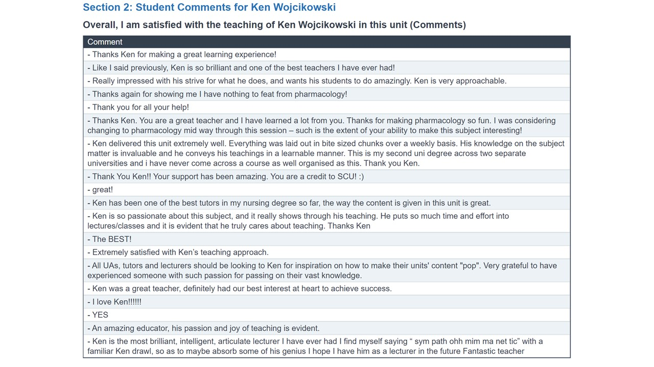

Slide 5
PHAR 2001 Student satisfaction: What to expect
In the past 8 years, since Ken Wojcikowski has been delivering this unit, the mean student satisfaction with the unit has been 4.56 out of 5
Recent Improvements:
Cut the length of the case study in half
Decreased the Tutorial questions from 5 to 2
The only quiz is on Module 1

Slide 6
PHAR 2001 Unit performance: What to expect
Generally, over 90% of students pass the first time
Most important: Attend tutorials weeks 2, 3, 4 and 5 and engage in Module 1

Slide 7
Autonomic Nervous System Pharmacology
Introduction to the PHAR2001 website
Introductory Pharmacology PHAR2001
Dr Ken Wojcikowski

Slide 8
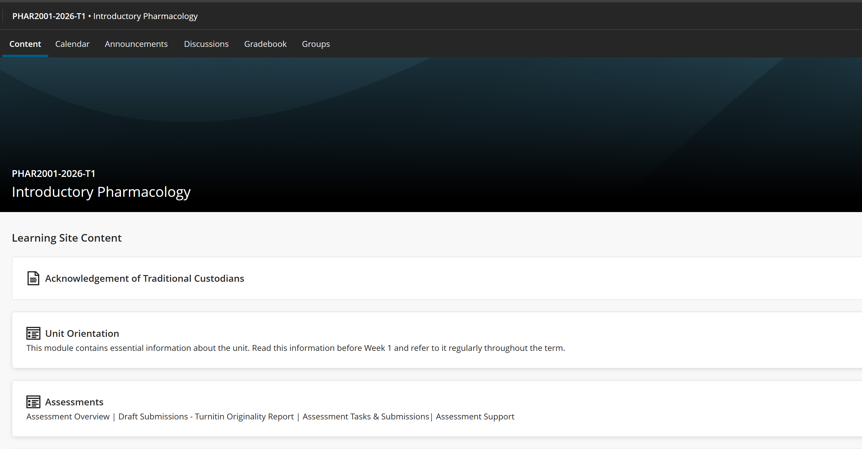

Slide 9
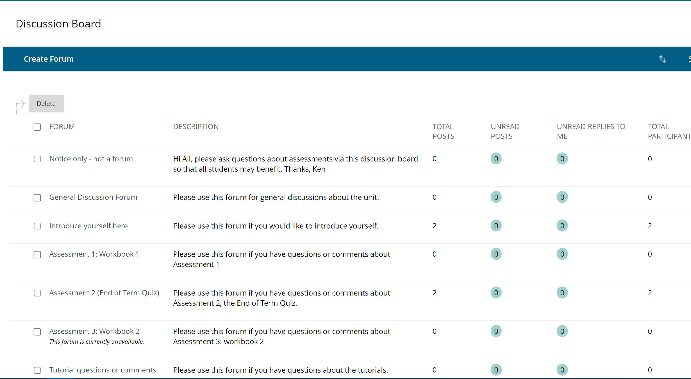

Slide 10
Autonomic Nervous System Pharmacology
The unit content:
Your ‘Interactive Pharmacology Textbook’
Introductory Pharmacology PHAR2001
Dr Ken Wojcikowski

Slide 12
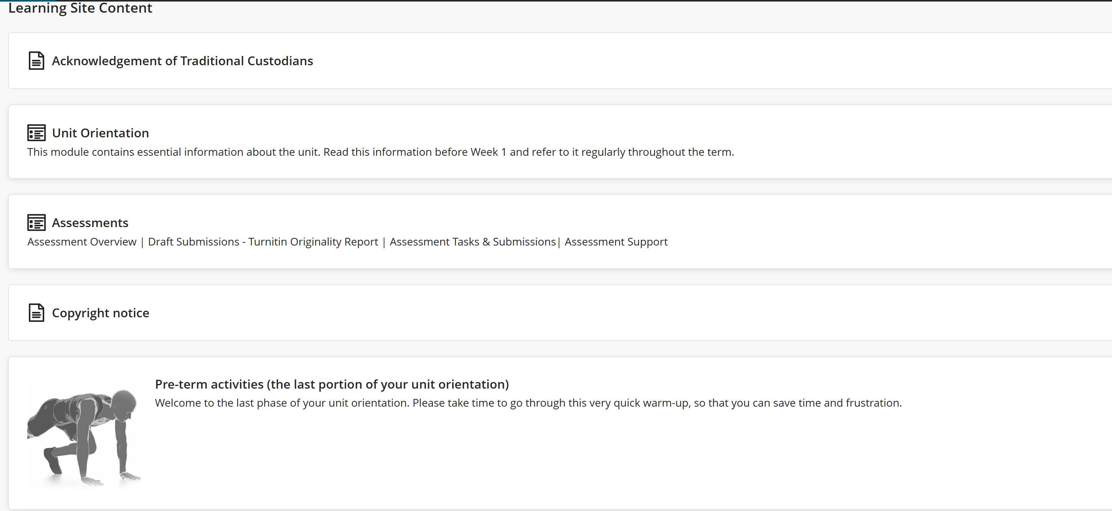
This is the unit orientation
Please be sure to engage in both portions of the unit orientation prior to starting on the modules!

Slide 13
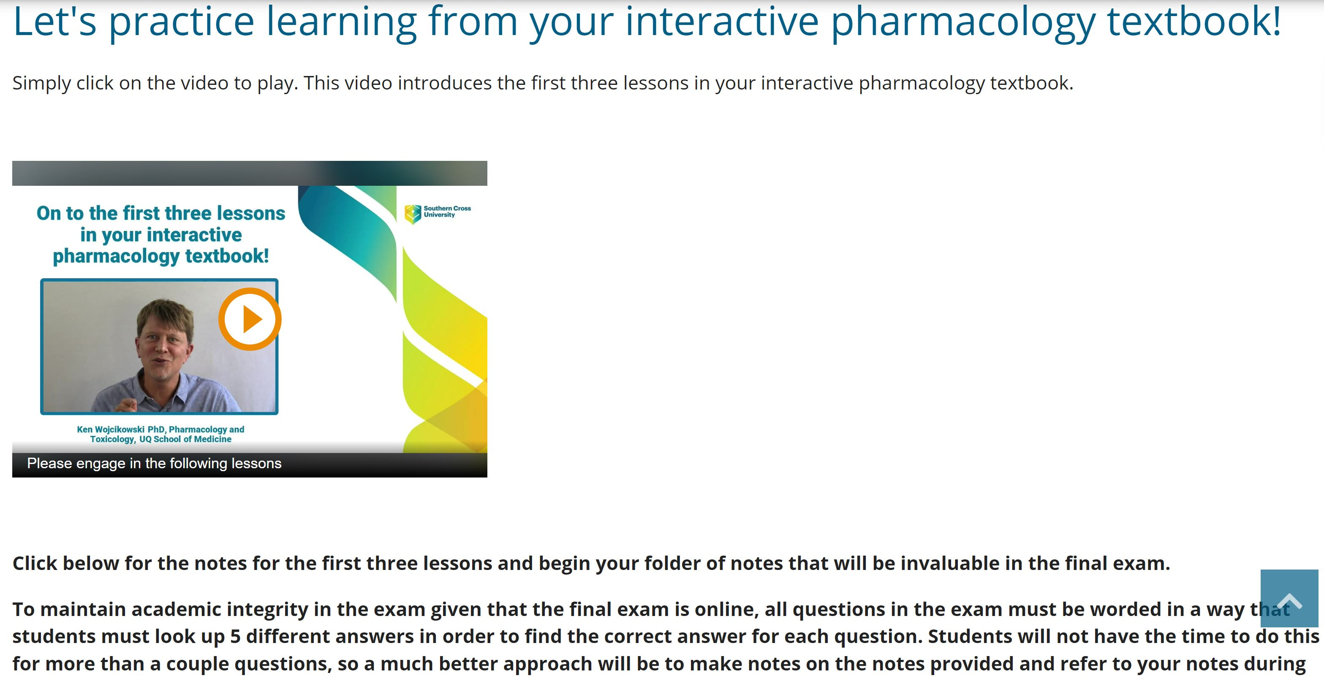

Slide 14
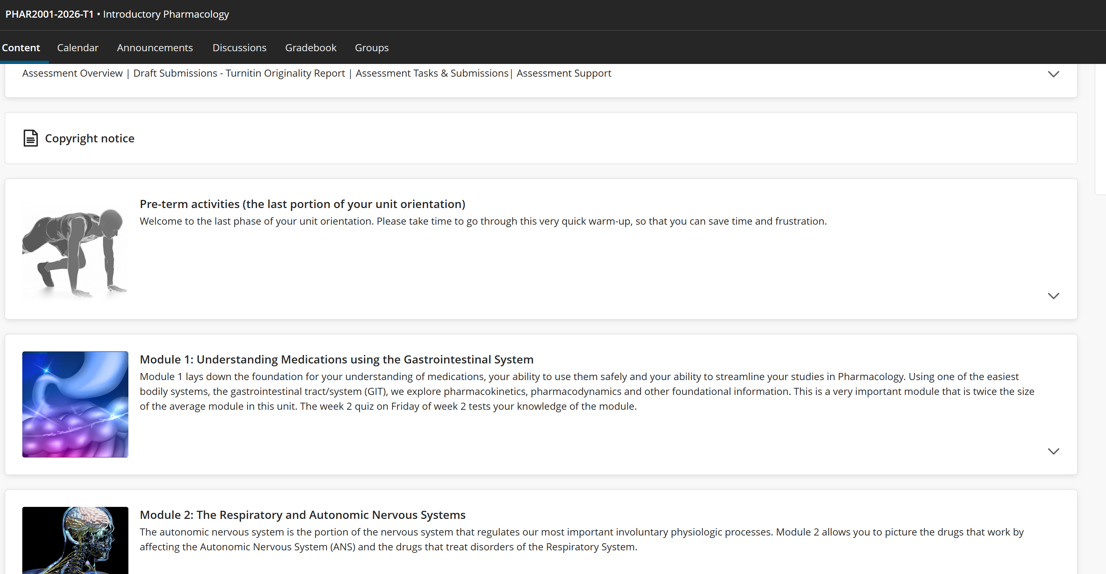

Slide 15
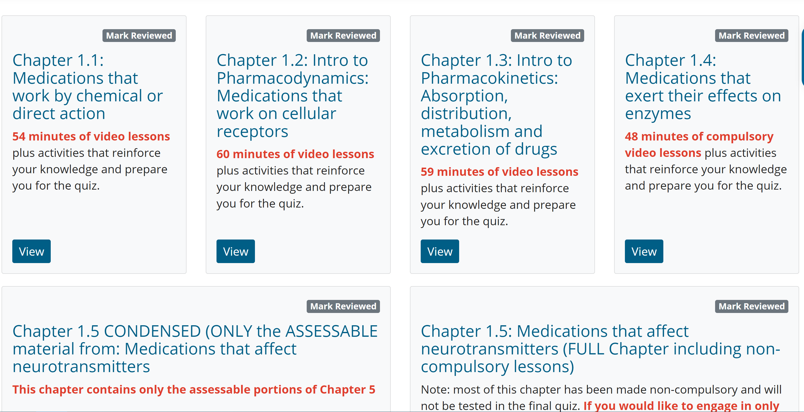
Module 1

Slide 16
Introductory Pharmacology Week 1 Tutorial
Part 2:
Overview of assessments
Ken Wojcikowski (PhD; Pharmacology and Toxicology, UQ School of Medicine)

Slide 18
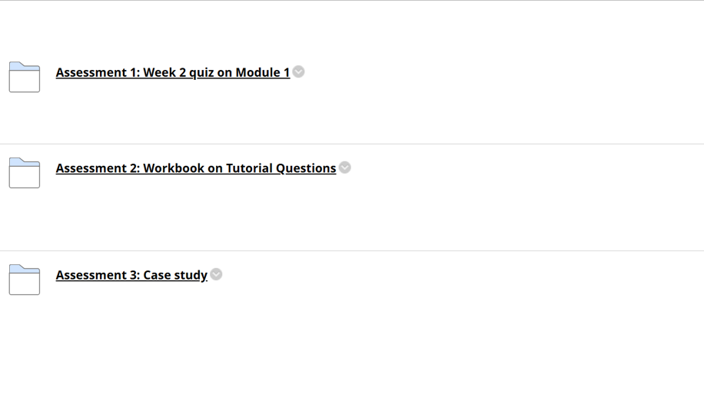
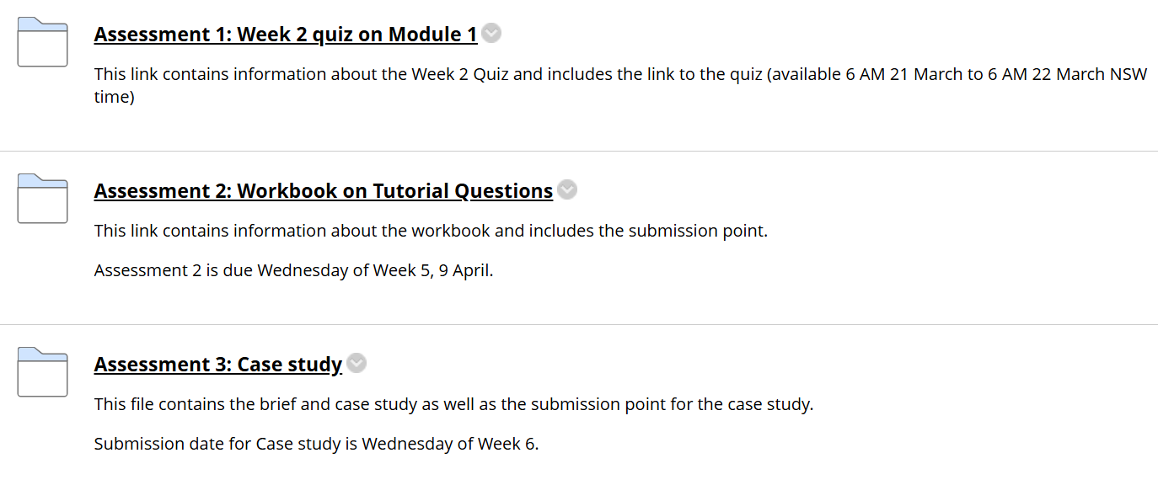

Slide 19
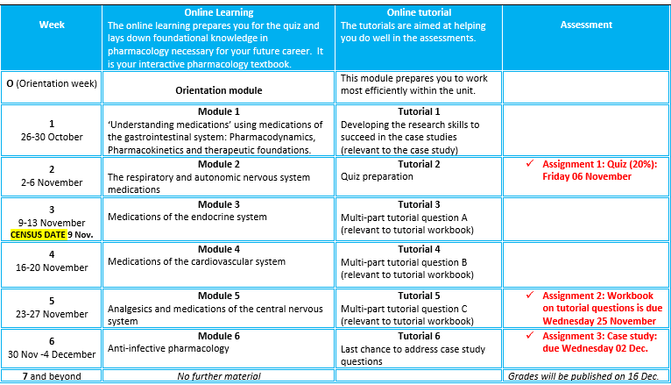
Autonomic Nervous System Pharmacology
Introductory Pharmacology PHAR2001
Dr Ken Wojcikowski

Slide 20
Autonomic Nervous System Pharmacology
Assessment 1:
Week 2 quiz
Introductory Pharmacology PHAR2001
Dr Ken Wojcikowski

Slide 21
Week 2 quiz
Worth 20% of your grade in the unit
Assesses your knowledge of module 1
  32 Multiple choice questions
  90 minutes
2 – 2-point questions
  The 2-point questions can only be answered if you attend the tutorial in week 2.

Slide 22
How to pass the quiz
Watch the video lessons in Module 1
Engage in the activities after each lesson
Go to the Week 2 tutorial, taking good notes
Re-engage in the activities, adding to your notes
Without a good understanding of the basics of pharmacology, you will not understand future topics, so decide by Census date if you are ready to progress

Slide 23
Autonomic Nervous System Pharmacology
Introductory Pharmacology PHAR2001
Dr Ken Wojcikowski

Slide 24
Autonomic Nervous System Pharmacology
Assessment 2:
Workbook:
Multipart tutorial questions
(worth 30%)
Introductory Pharmacology PHAR2001
Dr Ken Wojcikowski

Slide 25
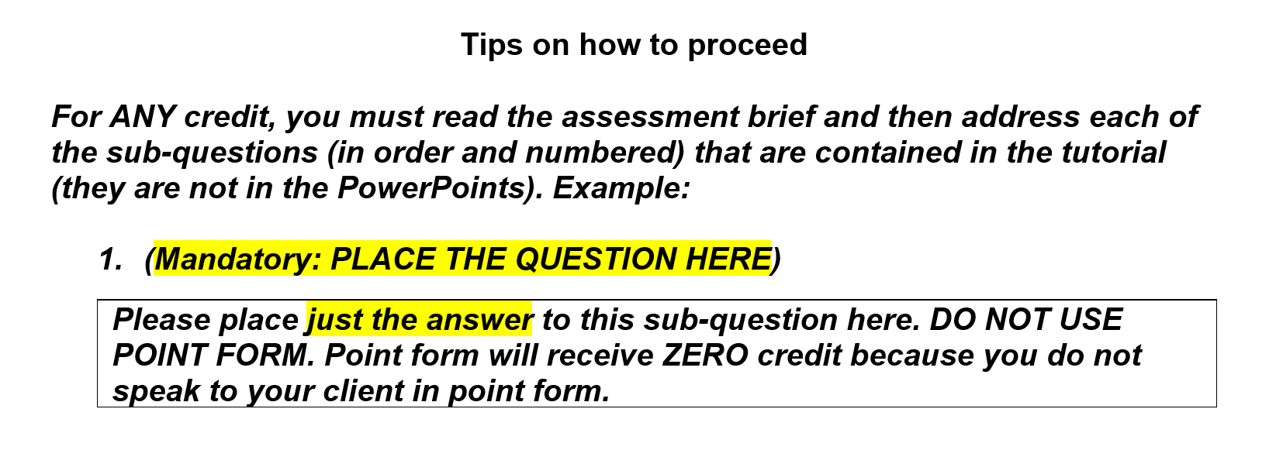

Slide 26
Autonomic Nervous System Pharmacology
Introductory Pharmacology PHAR2001
Dr Ken Wojcikowski

Slide 27
Autonomic Nervous System Pharmacology
Assessment 3: Case study
(worth 50% of your grade)
Introductory Pharmacology PHAR2001
Dr Ken Wojcikowski

Slide 28
Autonomic Nervous System Pharmacology
Introductory Pharmacology PHAR2001
Dr Ken Wojcikowski

Slide 29
The case study
You are working at a multidisciplinary clinic
Other healthcare workers are all busy and it is your responsibility to answer questions from clients and colleagues, using the most reliable resources.
The information you provide must be safe, accurate and current

Slide 30
Why don’t we get the specific resources that answer the case study questions?
Assessment 3 does not test your knowledge of the material that we provide you.
It helps you develop the skill of finding reliable safe information about drugs

Slide 31
How do we know that we are on the right track with the case study?
The workshops help answer your questions about the case study.
Send in your questions by Tuesday, and we will address them in the tutorial
The discussion board will open up the question to other students.

Slide 32
Introductory Pharmacology Week 1 Tutorial
Part 3:
More about the case study
Ken Wojcikowski (PhD) Pharmacology and Toxicology, UQ School of Medicine

Slide 33
Autonomic Nervous System Pharmacology
More details on the
Case Studies
Introductory Pharmacology PHAR2001
Dr Ken Wojcikowski

Slide 34
Autonomic Nervous System Pharmacology
Introductory Pharmacology PHAR2001
Dr Ken Wojcikowski

Slide 35
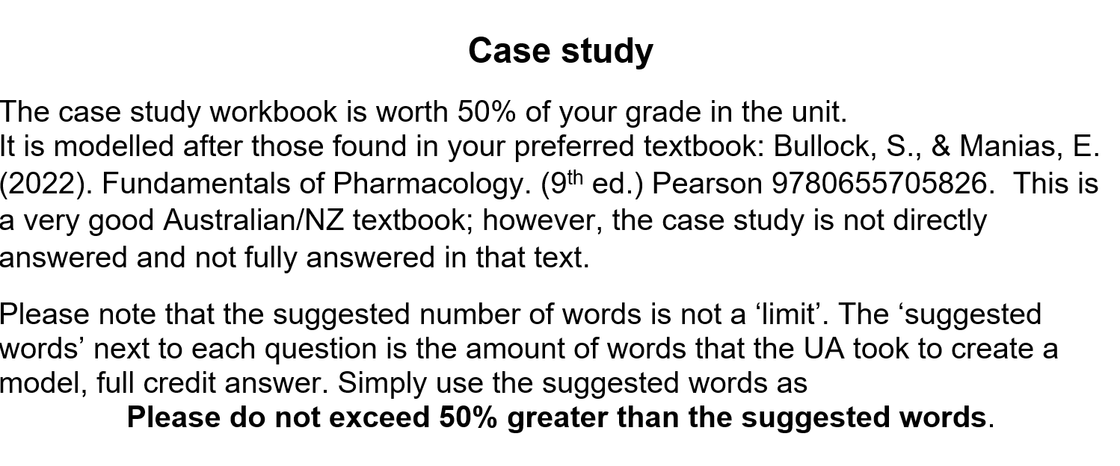
Autonomic Nervous System Pharmacology
Case study
(worth 50% of your grade)
Introductory Pharmacology PHAR2001
Dr Ken Wojcikowski

Slide 36
The case study
Has 5 portions, corresponding to the material in Weeks 2, 3, 4, 5 and 6
The modules do not answer the case but help you save time researching because you understand the topics
Make sure you spend a couple hours / week on the case study because
  The material is fresh on your mind
  You can ask questions that we can address in the workshop

Slide 37
The case study
You are working at a multidisciplinary clinic
Other healthcare workers are all busy and it is your responsibility to answer questions from clients and colleagues, using the most reliable resources.
The information you provide must be safe, accurate and current

Slide 38
A word about
Academic Integrity
The clips of websites in this tutorial were necessary to guide students on the most appropriate websites and are referenced within the tutorial.
Please remember that it is a breach of academic integrity to copy other’s work and use that work as your own.
Please refer to the SCU Academic Integrity Policy for further information.

Slide 39
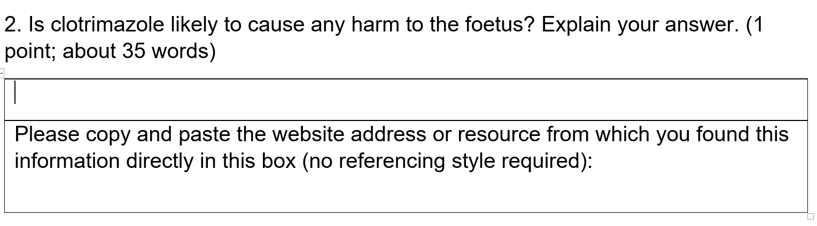
Reference:

Slide 40
Introductory Pharmacology Week 1 Tutorial
Part 4: Researching the case study
Ken Wojcikowski (PhD) Pharmacology and Toxicology, UQ School of Medicine

Slide 41
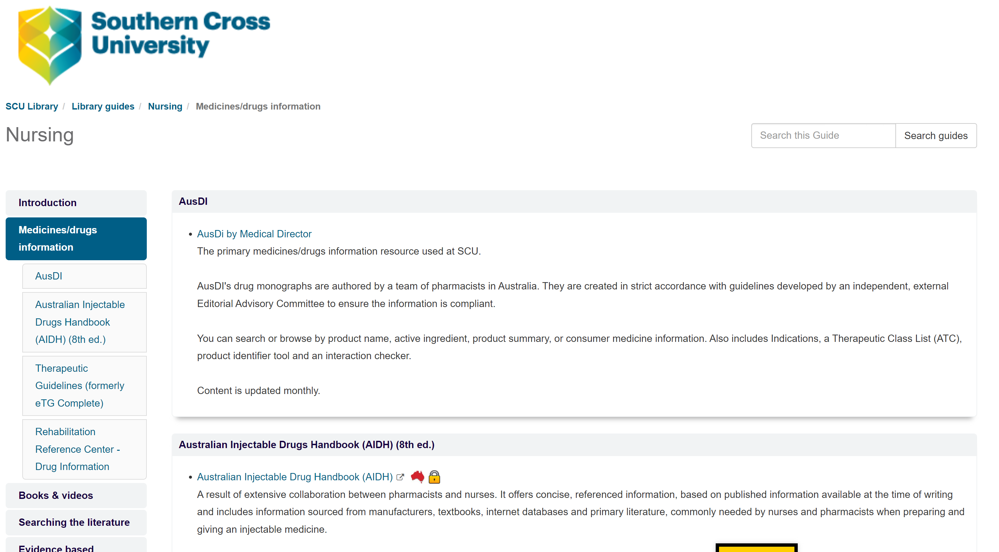
What resources does the library have?

Slide 42
What resources does the library have?

Slide 43
Autonomic Nervous System Pharmacology
Specific resources for
Researching Case Studies
Introductory Pharmacology PHAR2001
Dr Ken Wojcikowski

Slide 44
Example of a
Typical workbook question
HH is a 28-year-old pregnant woman who visits her midwife for her antenatal check-up. She is eight months pregnant and speaks to her midwife about clotrimazole 2 percent vaginal cream prescribed by her local doctor for vulvovaginal candidiasis. ………………she is very concerned about the possible harm of the medicine to her baby.
Question
Is clotrimazole likely to cause any harm to the foetus? Explain your answer.
Notes:
Is clotrimazole likely to cause any harm to the foetus? Explain your answer. (0.5 point; two coherent sentences of no more than 50 words)

Slide 45
…just Google it??

Slide 46
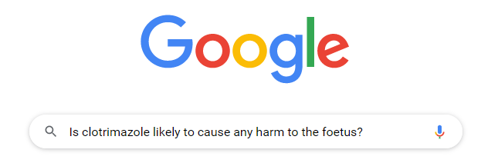
Google it!
About 2,170,000 results
But which result will contain the information you need?
  Directed to health professionals
  Accurate
  evidence based
  unbiased
  up to date
  relevant in Australia?

Slide 47
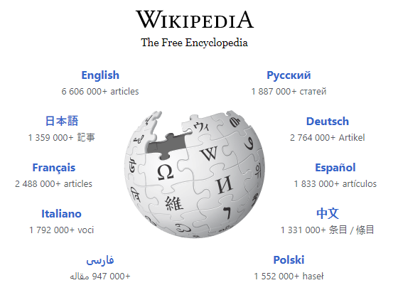
What about Wikipedia?
May be helpful for a general overview
But you need to check the references
  Are they from reliable sources?
  Are they unbiased or are they provided by the medicine sponsor/manufacturer?
  Publication date?
https://www.wikipedia.org/

Slide 48
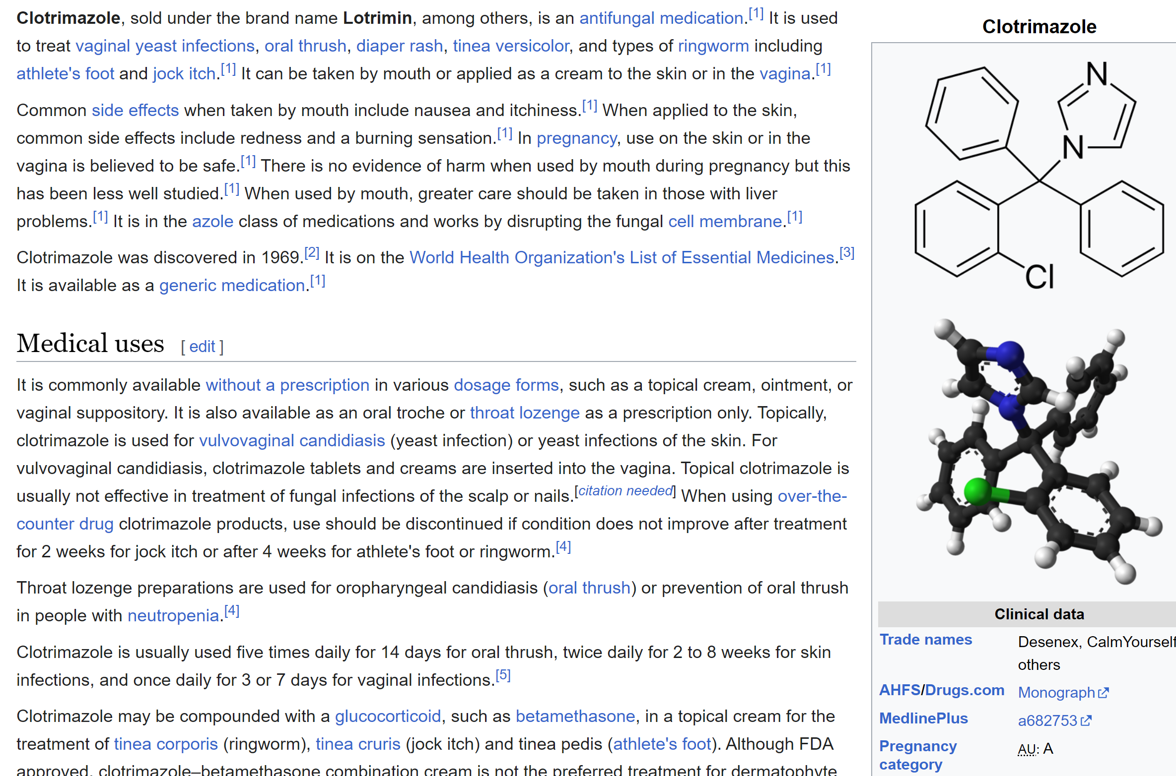


Slide 49
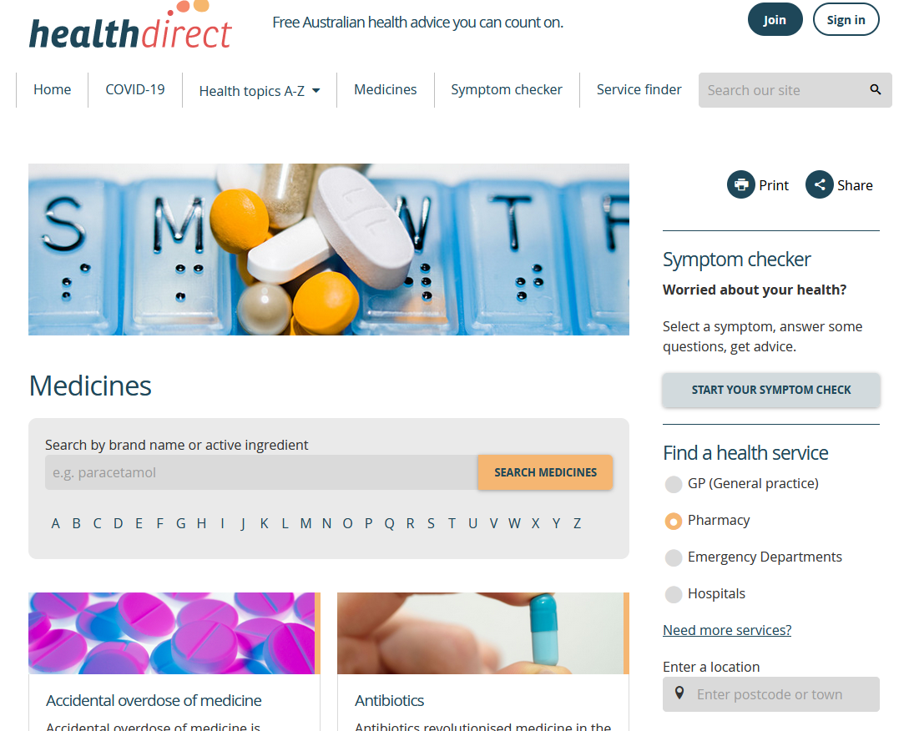
Australian government consumer sites ?
https://www.healthdirect.gov.au/medicines
Notes:
Pretty slow
Includes a list of branded products

Slide 50
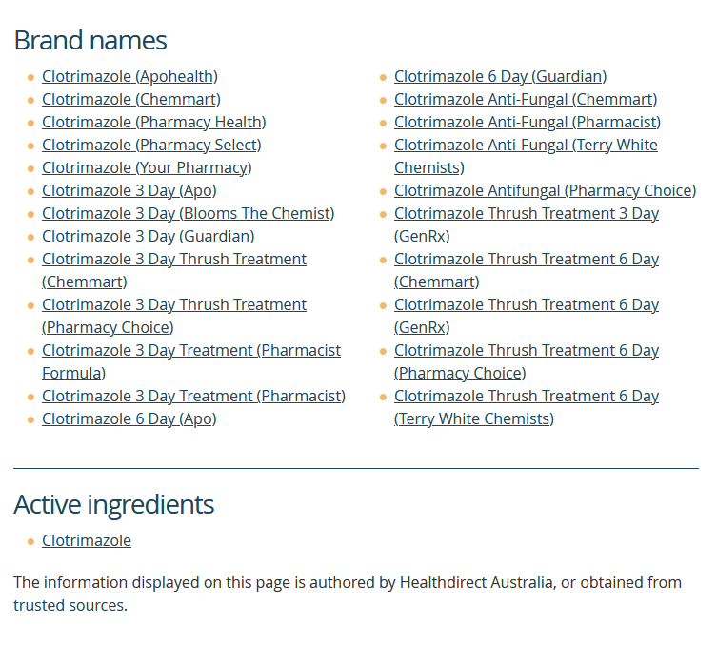
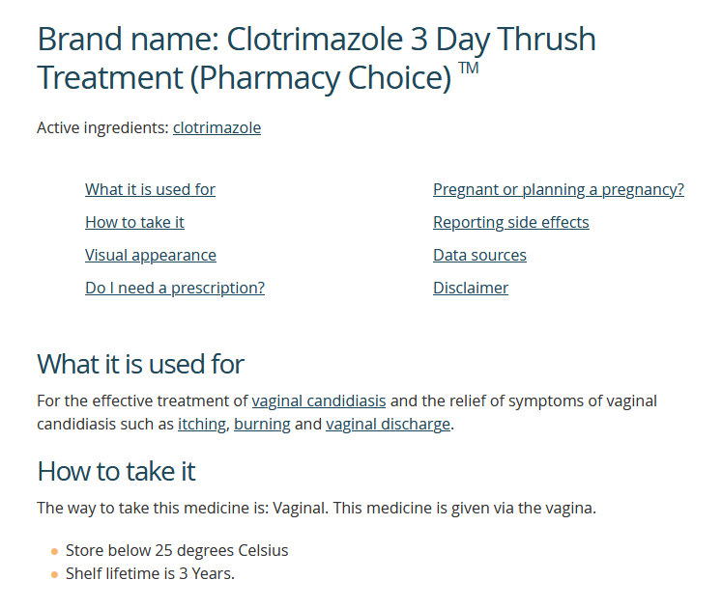
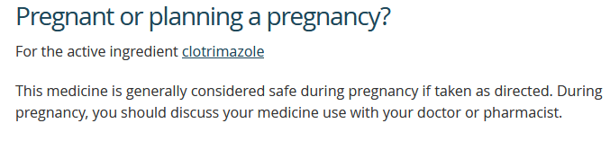
https://www.healthdirect.gov.au/medicines/brand/amt,735751000168105/clotrimazole-apohealth
Notes:
Useful when you know the exact medication.
Many of these medications listed are not actually available for sale in Australia any more….so it’s time consuming and the information is minimal.

Slide 51
Autonomic Nervous System Pharmacology
Websites for health professionals
Introductory Pharmacology PHAR2001
Dr Ken Wojcikowski

Slide 52
Websites for
Health Professionals
NPS MEDICINEWISE
Medicine Finder: provides links to information about many types of medicines
https://www.nps.org.au/medicine-finder
Hosted by the Australian Commission on Safety and Quality in Health Care
Drawbacks
Descriptions provided by the manufacturer
Many medicines not yet included in the database
Notes:
National Prescribing Service (NPS)
1 January 2023, the Australian Commission on Safety and Quality in Health Care (the Commission) is now responsible for several Quality Use of Medicines functions that were formerly delivered by NPS MedicineWise.
So standby for changes, but for now the link works
This website is now hosted by the Australian Commission on Safety and Quality in Health Care as part of the redesign of the Quality Use of Diagnostics, Therapeutics and Pathology program.

Slide 53
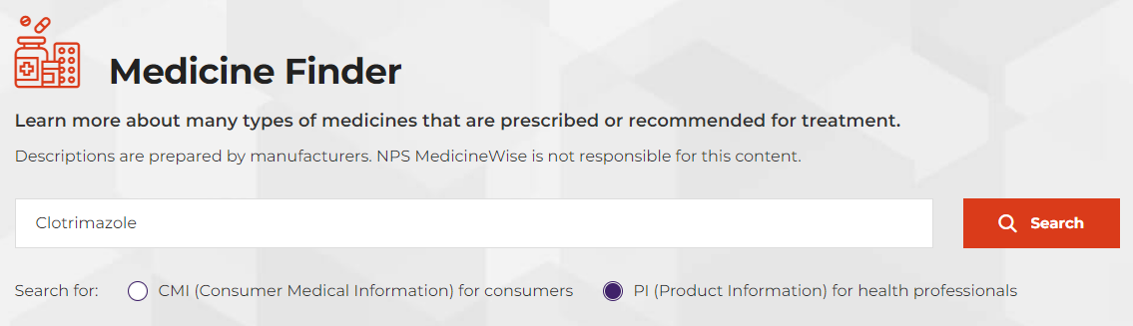
Medicine Finder
Clotrimazole – no results
Canesten – no results

Slide 54
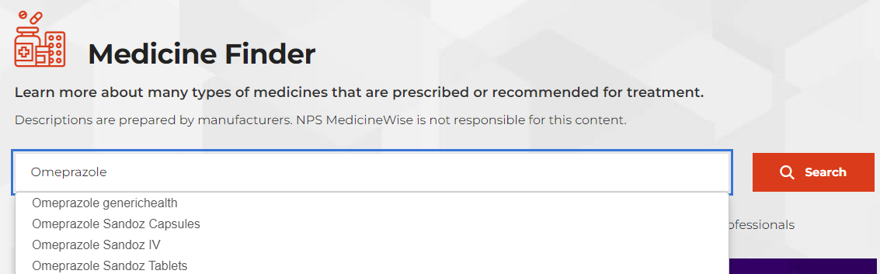
Proton pump inhibitor – frequently prescribed class of medicines

Slide 55

Drugs.com
This website is from the United States and draws its information from a range of independent sources such as the FDA, The American Society of Health-System Pharmacists and Harvard Health.
The Pro Edition - for healthcare professionals.
AHFS DI Monographs – drug information
FDA Professional Drug Information
Drug Interaction Checker
Professional Patient Advice
And more
https://www.drugs.com/professionals.html
Notes:
For Healthcare Professionals
Drugs.com provides access to healthcare information tailored for a professional audience - sourced solely from the most trusted, well-respected and independent agents such as the American Society of Health-System Pharmacists (ASHP), FDA, Truven Health Analytics, Harvard Health and Cerner Multum.
Harvard Health Topics
Sourced from Harvard Health Publishing, these articles include detailed information about medical conditions, diseases, procedures and devices. Includes definitions, descriptions, symptoms, diagnosis, treatments, prognosis and other resources.
Lets try out 2 of these options and see how useful they are for the case study …and future use

Slide 56
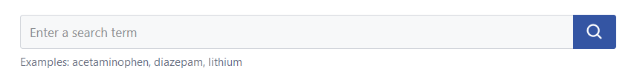
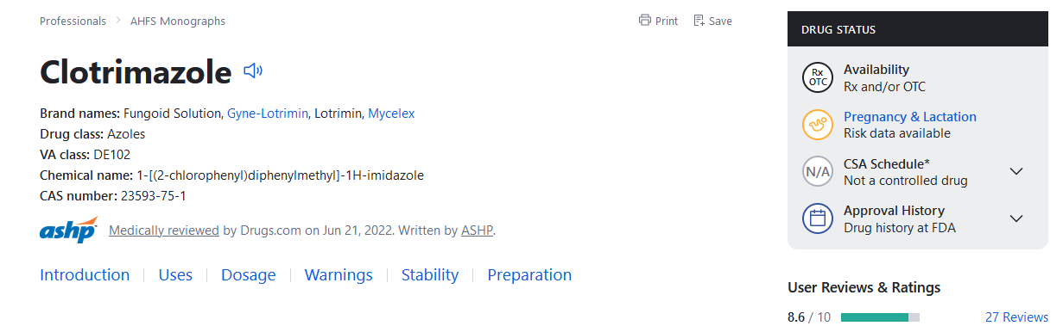
American Hospital Formulary Service
AHFS DI Monographs
https://ahfsdruginformation.com/
Notes:
Highly respected resource: AHFS DI has been listed by the American College of Physicians-as a standard item for inclusion in reference libraries. (available from Drugs.com or directly through its own website.)
Monographs include the recommendations of numerous authorities, including the U.S. Centers for Disease Control and Prevention, the American Heart Association, the Institute of Medicine of the National Academies, the Women’s Health Initiative and many others.
The publication also features major cautionary information from FDA MedWatch notices as well as new and updated scientific findings.
If you scroll down the page you will find the information about the drug under the headings listed across the bottom in blue
Introduction/ uses /dosage/warnings etc. But remember this relates to the FDA regulations and not to TGA regulations

Slide 57
AHFS Monograph on Clotrimazole
Introduction
Antifungal; azole (imidazole derivative).
Uses for Clotrimazole
keep on scrolling to find the condition in the case study…
Vulvovaginal Candidiasis
Treatment of uncomplicated vulvovaginal candidiasis (mild to moderate, sporadic or infrequent, most likely caused by Candida albicans, occurring in immunocompetent women).
https://www.drugs.com/monograph/clotrimazole.html

Slide 58
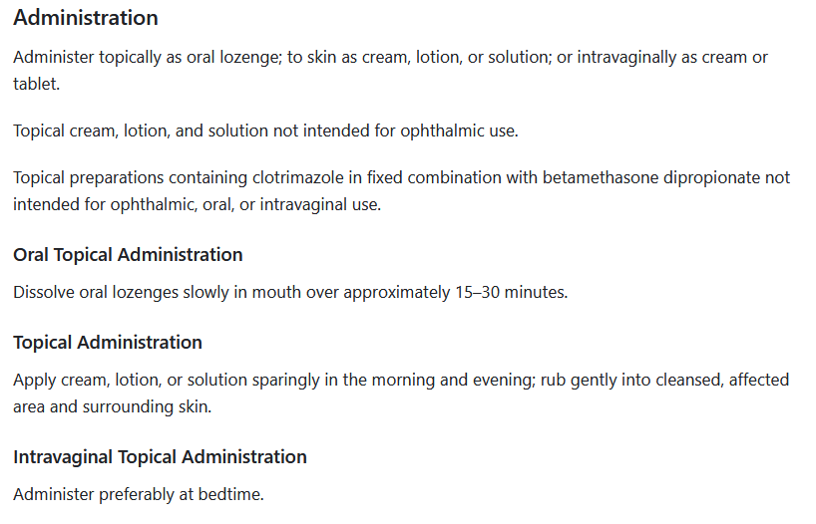
AHFS Monograph Clotrimazole Dosage and Administration
https://www.drugs.com/monograph/clotrimazole.html

Slide 59

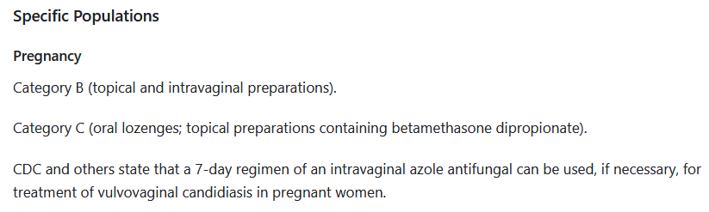
AHFS Monograph Cautions for Clotrimazole
https://www.drugs.com/monograph/clotrimazole.html
https://upload.wikimedia.org/wikipedia/en/thumb/a/a4/Flag_of_the_United_States.svg/255px-Flag_of_the_United_States.svg.png
Notes:
Note the classification used by the FDA in pregnancy isn’t the same as the one adopted by the TGA.
Goes on to cover Pharmacokinetics etc.

Slide 60
AHFS DI Monographs
https://www.drugs.com/monograph/clotrimazole.html
Notes:
Remember there was also a link to pregnancy and lactation data at the beginning of the monograph – compare the information it provides

Slide 61
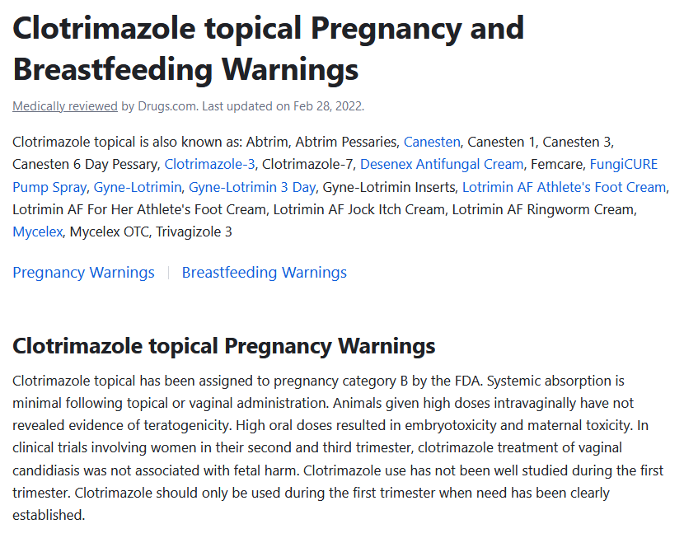
Notes:
More information – provides the health professional with the research context as well as a simply identifying a category.

Slide 62
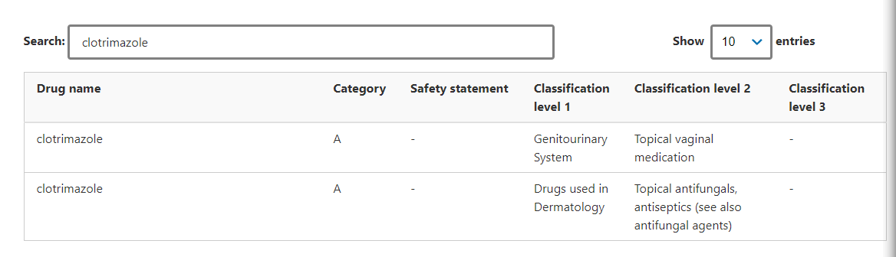
Therapeutic Goods Administration TGA
The Australian categorisation system for prescribing medicines in pregnancy was developed for the TGA by a group of medical and scientific experts based on available evidence of risks associated with taking a particular medicines while pregnant.
A searchable database is available
https://www.tga.gov.au/australian-categorisation-system-prescribing-medicines-pregnancy
Notes:
developed by medical and scientific experts based on available evidence of risks associated with taking particular medicines while pregnant.
So how is clotrimazole categorized in the Aussie system? That’s right, both the topical vaginal and general antifungals are A.

Slide 63
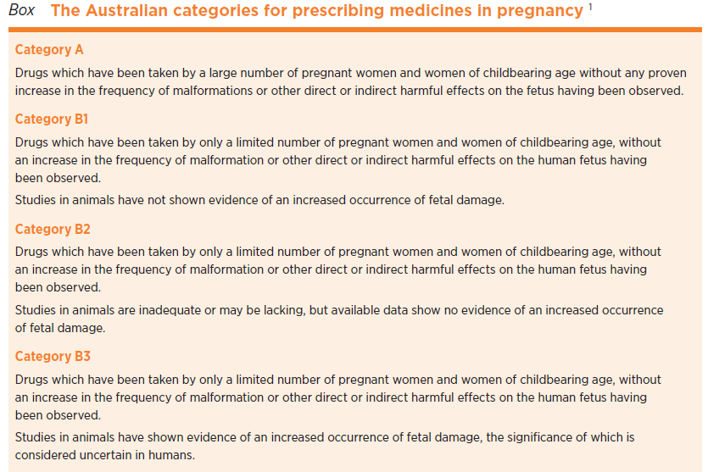
Classifying drugs in pregnancy:
The Australian
system
Kennedy D. Classifying drugs in pregnancy. Aust Prescr 2014;37:38-40.https://doi.org/10.18773/austprescr.2014.018

Slide 64
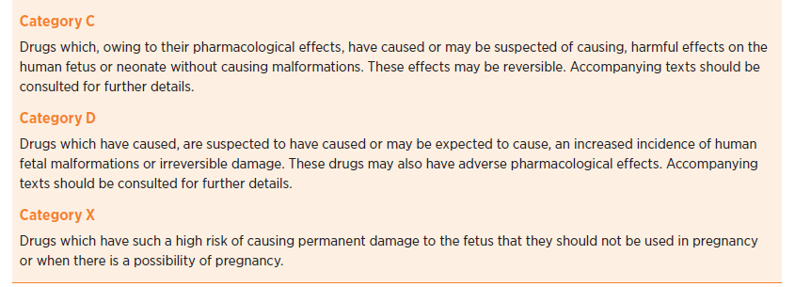
Classifying drugs in pregnancy:
The Australian
system

Slide 65
The TGA prescribing medicines in pregnancy database
https://www.tga.gov.au/australian-categorisation-system-prescribing-medicines-pregnancy
Notes:
developed by medical and scientific experts based on available evidence of risks associated with taking particular medicines while pregnant.
So how is clotrimazole categorized in the Aussie system? That’s right, both the topical vaginal and general antifungals are A.

Slide 66

MotherToBaby
Scroll on down in Health Professionals
https://mothertobaby.org/healthcare-professionals/
Notes:
MotherToBaby, a service of the non-profit Organization of Teratology Information Specialists (OTIS), is the nation’s leading authority and most trusted source of evidence-based information on the benefit or risk of medications and other exposures during pregnancy and while breastfeeding.
Pretty sure the midwifery students are all over this one! Right, I thought so. But for the rest of us…
There is a drop down menu with various options, but for our purposes, simply scroll down the page to Discover our patient education materials and healthcare professional resources by selecting your specialty: :

Slide 67

Access to MotherToBaby Factsheets
Click Explore to take you to the webpage
Use the link to get directly into the factsheets
https://mothertobaby.org/fact-sheets/
Notes:
Scroll down to find the link webpage that gives you access to the factsheets, or use the link to get you straight there.
An absolute great resource, but is it appropriate for your assignment – well no

Slide 68
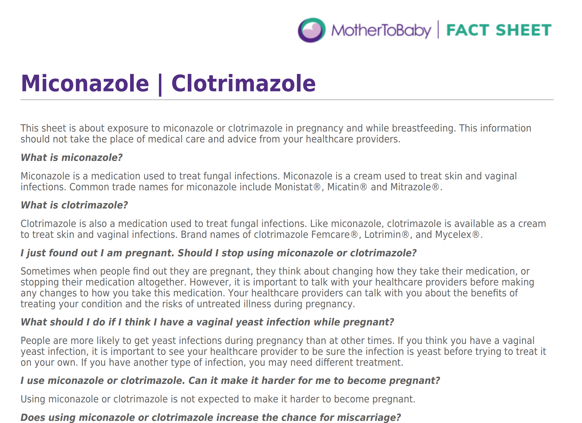
https://mothertobaby.org/fact-sheets/miconazoleclotrimazole-pregnancy/
Notes:
Just check out the language – simple straightforward

Slide 69
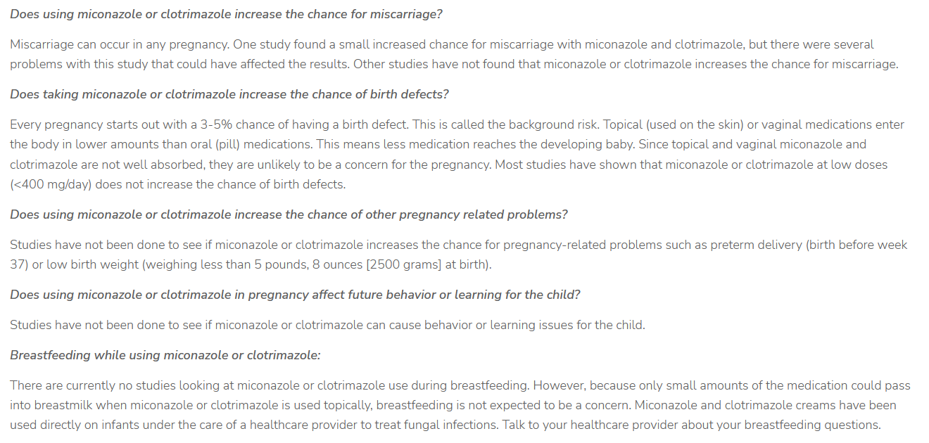
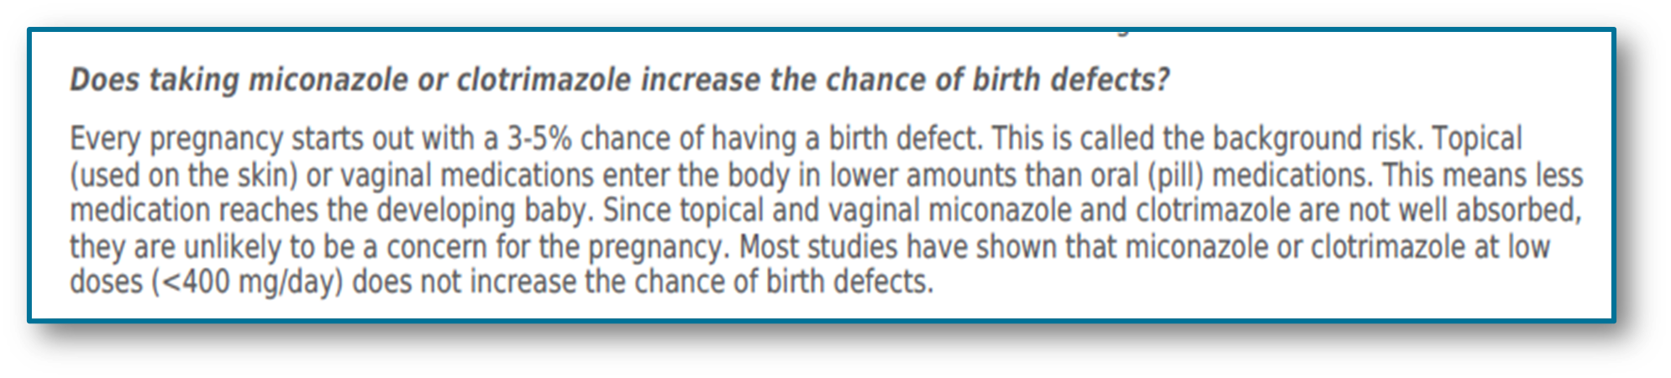
s://mothertobaby.org/fact-sheets/miconazoleclotrimazole-pregnancy/
https://mothertobaby.org/fact-sheets/miconazoleclotrimazole-pregnancy/
Notes:
And here is the bit we are interested in.

Slide 70
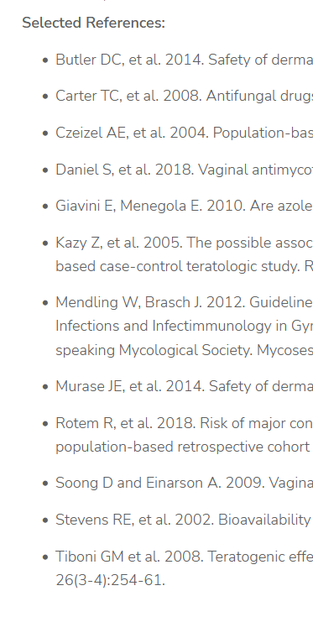
Access to MotherToBaby Factsheets
Is this the best resource for the assignment or to inform a health professional?
Lacks the drug classification details
Hard to judge how up to date it is as the link provides only selected references.
More recent research available
https://mothertobaby.org/fact-sheet-reference/miconazoleclotrimazole/
Notes:
Scroll down to find the link webpage that gives you access to the factsheets, or use the link to get you straight there.

Slide 71
Introductory Pharmacology Week 1 Tutorial
Part 5:
Peer reviewed research
Ken Wojcikowski (PhD) Pharmacology and Toxicology, UQ School of Medicine

Slide 72
Peer reviewed research
If all else fails and you have not found what you are looking for, you can check out the peer reviewed search engines PubMed and Google Scholar.
Autonomic Nervous System Pharmacology
Introductory Pharmacology PHAR2001
Dr Ken Wojcikowski

Slide 73
Sourcing your answer from peer reviewed papers
Latest and greatest sources
  PubMed
  Google Scholar or
  SCU library*

Slide 74
PubMed
PubMed is a collection of millions of biomedical journal citations and abstracts as well as some books/chapters.
It provides links to full text of journal papers that are open access
PubMed is free and global
Content
MEDLINE – the National Library of Medicine database
PubMed Central (PMC)
Bookshelf – archive of full text books reports
Notes:
https://pubmed.ncbi.nlm.nih.gov/

Slide 75
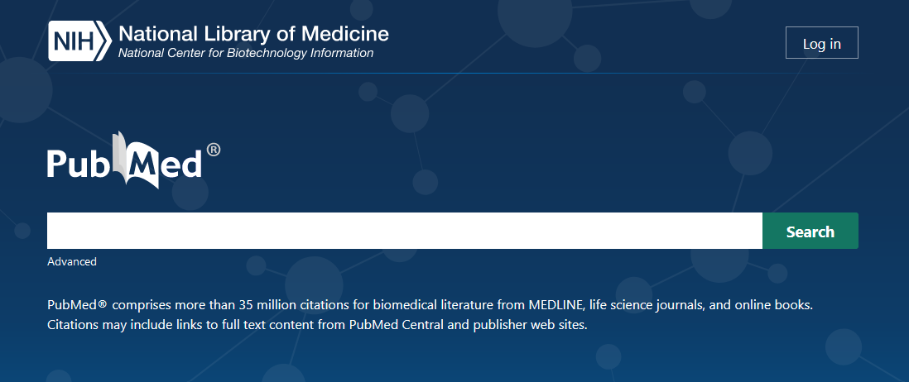
PubMed
https://pubmed.ncbi.nlm.nih.gov/
Notes:
Hit this link, or simply type PubMed into your browser and you will find this page.
Couple of things to note here – first the URL ends in .gov – a website sponsored by a government – it’s the US government through the National Library of Medicine
Note too that there are two search options – we will explore them both.
You can create a free account with the PubMed, but it isn’t necessary.

Slide 76
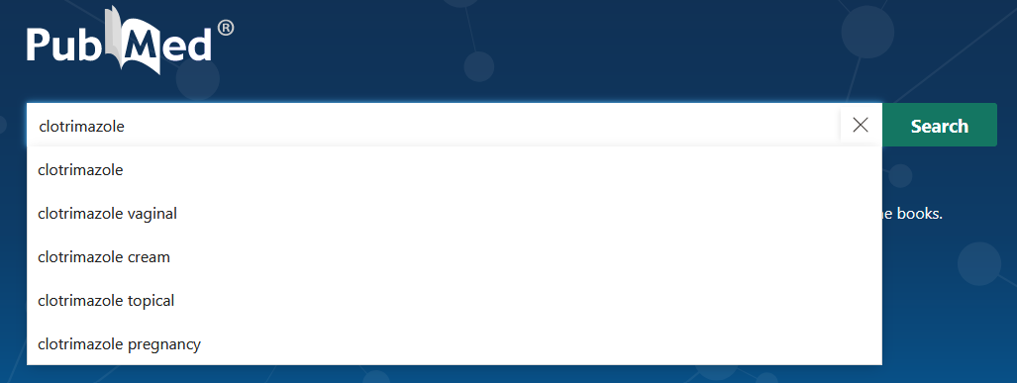
Simple search
Typing a medication name brings up several search options
Notes:
As you enter the medication name, PubMed provides additional search terms – let’s compare a couple of searches - a general search of the medication and the search that specifically mentions pregnancy.

Slide 77
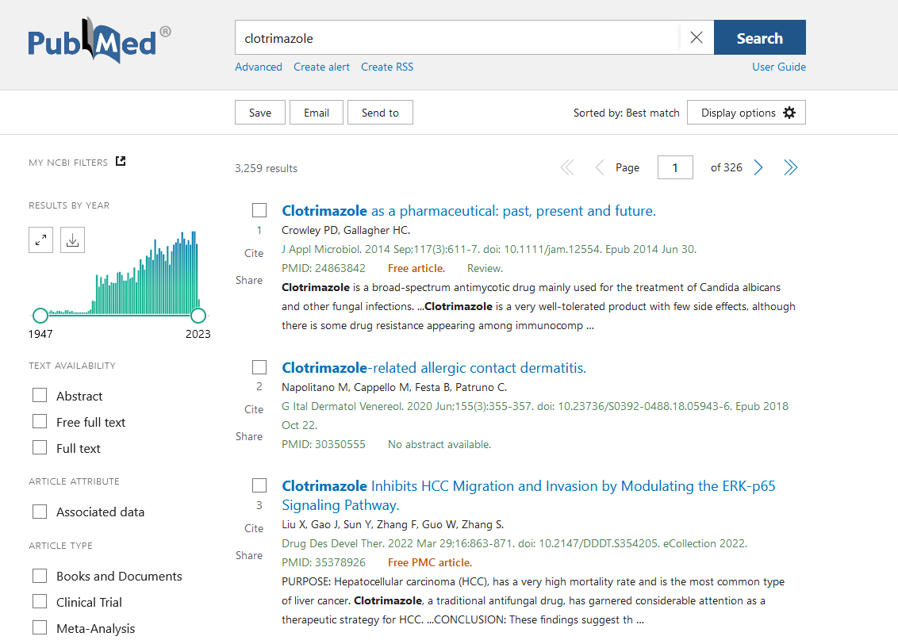
https://pubmed.ncbi.nlm.nih.gov/?term=Clotrimazole
Notes:
The default display of a PubMed search shows 10 articles per page – here we have just the first 3. Let’s take a look at the page and work out how to change aspects of the search to make finding what we are really interested in quicker and easier.
First up – you can see there are 3 259 citations that include clotrimazole – PubMed lists them in order of relevance to your search, so the first ones listed will likely have the search term in the title – this won’t be the case with all of them – and you will be seriously hoping to find what you need in the first 1-20 citations.
But which ones really matter to you? When the citation links directly to the full text article there is a note in red under the citation. Clicking on this will take you there.
Do you want to reduce the number of citations, or perhaps focus in on recent citations only? The graph on the left of the page shows you how often your search is cited in the years between 1947-2023. Could be you want to focus on information published in the last 10 years only.
Another ma

Slide 78
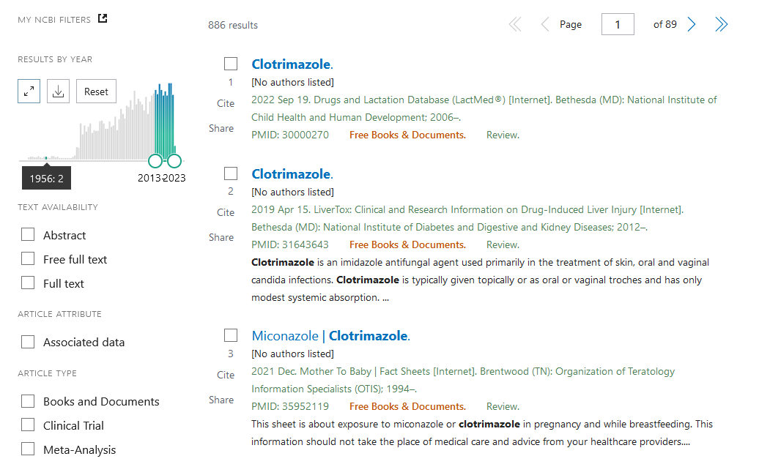
https://pubmed.ncbi.nlm.nih.gov/?term=Clotrimazole
Notes:
The default display of a PubMed search shows 10 articles per page – here we have just the first 3. Let’s take a look at the page and work out how to change aspects of the search to make finding what we are really interested in quicker and easier.
First up – you can see there are 3 259 citations that include clotrimazole – PubMed lists them in order of relevance to your search, so the first ones listed will likely have the search term in the title – this won’t be the case with all of them – and you will be seriously hoping to find what you need in the first 1- -20 citations.
Do you want to reduce the number of citations, or perhaps focus in on recent citations only? The graph on the left of the page shows you how often your search is cited in the years between 1947-2023. Could be you want to focus on information published in the last 10 years only.
Lets change the date parameters and see how that changes the results – you can do that on the graph, by toggling the x axis (horizontal bar) or x-axis on the graph - another way to focus your search by publication date is to use the filter
two important changes have occurred.
1st a drastic reduction in the number of citations – just 886
Let’s take a brief scroll down those first 10 citations and see if we have what we are looking for……

Slide 79
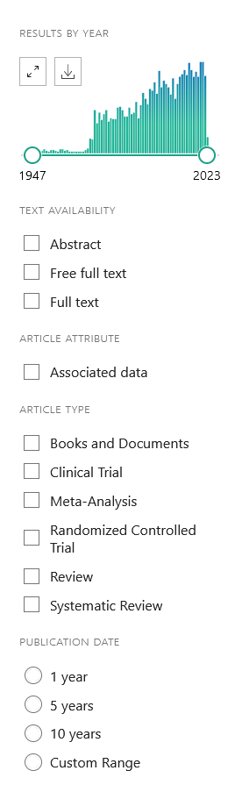
More filters
Check out the left hand column
Adjust your search fast, by ticking boxes
Options
TEXT AVAILABILITY: limit the search to citations with full text attached, or just free full text
ARTICLE ATTRIBUTE: rarely relevant
ARTICLE TYPE: depends on the research question you are answering
PUBLICATION DATE: focuses your search to a timespan
Notes:
Another way to apply filter is via clicking on boxes on the left hand side of the screen.
Associated data – probably not so helpful to you…

Slide 80
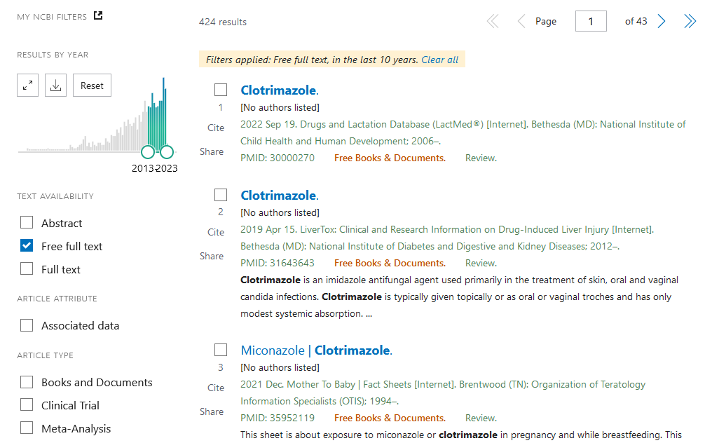
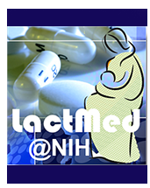


Now with two filters …
https://pubmed.ncbi.nlm.nih.gov/?term=Clotrimazole&filter=simsearch2.ffrft&filter=datesearch.y_10
Notes:
This is free full textThe number of citations is drastically reduced
And note that PubMed reminds you that you are working with filters in place.
Finally notice that the Free full text filter has thrown up some Free books and Documents, - another category to consider – will these provide the information you need?
The LactMed® database contains information on drugs and other chemicals to which breastfeeding mothers may be exposed. It includes information on the levels of such substances in breast milk and infant blood, and the possible adverse effects in the nursing infant. Suggested therapeutic alternatives to those drugs are provided, where appropriate. All data are derived from the scientific literature and fully referenced. A peer review panel reviews the data to assure scientific validity and currency.
LiverTox® provides up-to-date, unbiased and easily accessed information on the diagnosis, cause, frequency, clinical patterns and management of liver injury attributable to prescription and nonprescription medications and selected herbal and dietary supplements. The LiverTox site is meant as a resource for both physicians and patients as well as for clinical academicians and researchers who specialize in idiosyncratic drug induced hepatotoxicity.

Slide 81
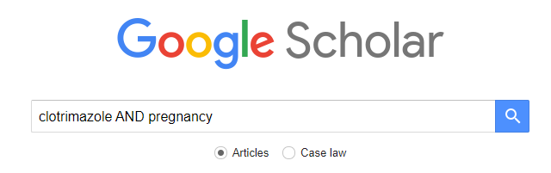
Searching with Google Scholar
https://scholar.google.com.au/ or simply search ‘Google Scholar’ and click

Slide 82
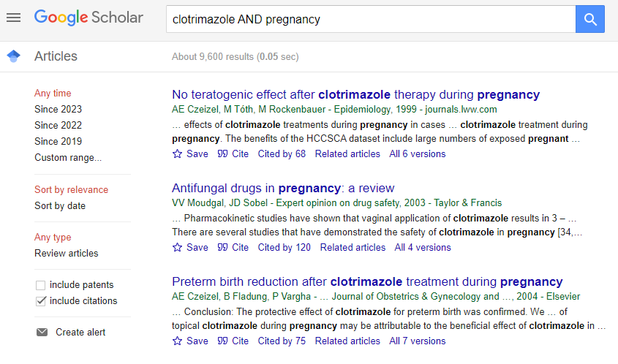
https://scholar.google.com.au/scholar?hl=en&as_sdt=0%2C5&q=clotrimazole+AND+pregnancy&btnG=
Notes:
What are we looking for?
Relevance
Date
Change the range.. Sort by date

Slide 83
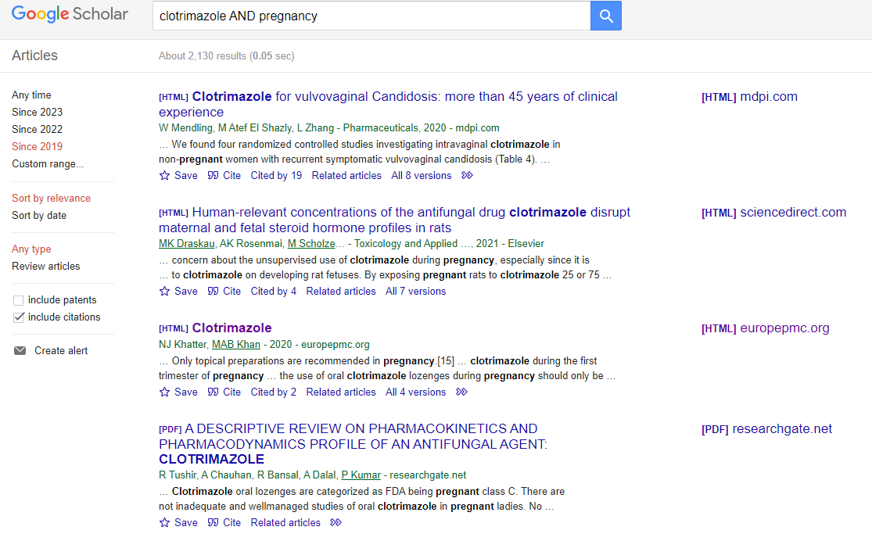
https://scholar.google.com.au/scholar?as_ylo=2019&q=clotrimazole+AND+pregnancy&hl=en&as_sdt=0,5
Notes:
Also available through PubMed

Slide 84
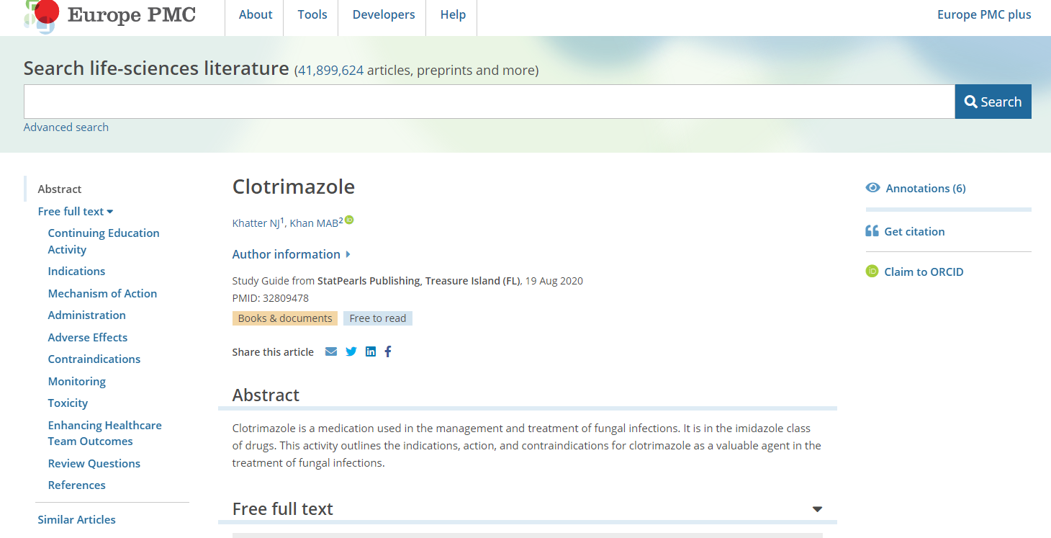
https://europepmc.org/article/nbk/nbk560643

Slide 85
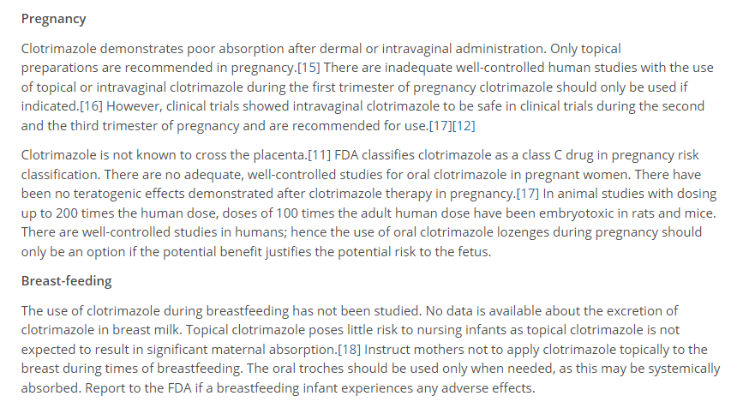
https://europepmc.org/article/nbk/nbk560643
Notes:
Extract from the full text

Slide 86
Autonomic Nervous System Pharmacology
Researching questions about Pharmacokinetics and Pharmacodynamics
Introductory Pharmacology PHAR2001
Dr Ken Wojcikowski

Slide 87
Pharmacokinetics
‘Pharmaco’ (drug or poison)
‘kinetics’ (movement of)
Imagine what our body does to the drug…
Absorption
Metabolism
Distribution
Excretion
Notes:
https://pubmed.ncbi.nlm.nih.gov/

Slide 88
Pharmacodynamics
Imagine what the drug does to our body…
Does it work on cellular receptors?
Does it work on enzymes?
Pharmacodynamics includes the mechanism of action
But we are only concerned about an overview of the mechanism of action – sometimes called ‘mode of action’
Notes:
https://pubmed.ncbi.nlm.nih.gov/

Slide 89
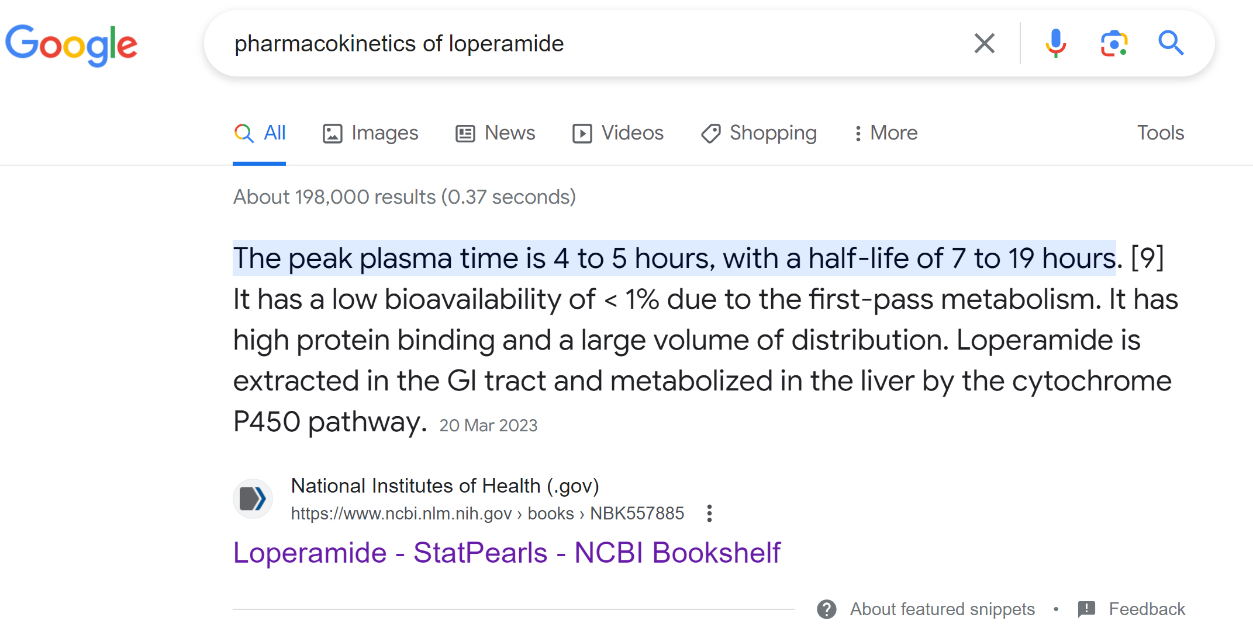

Slide 90
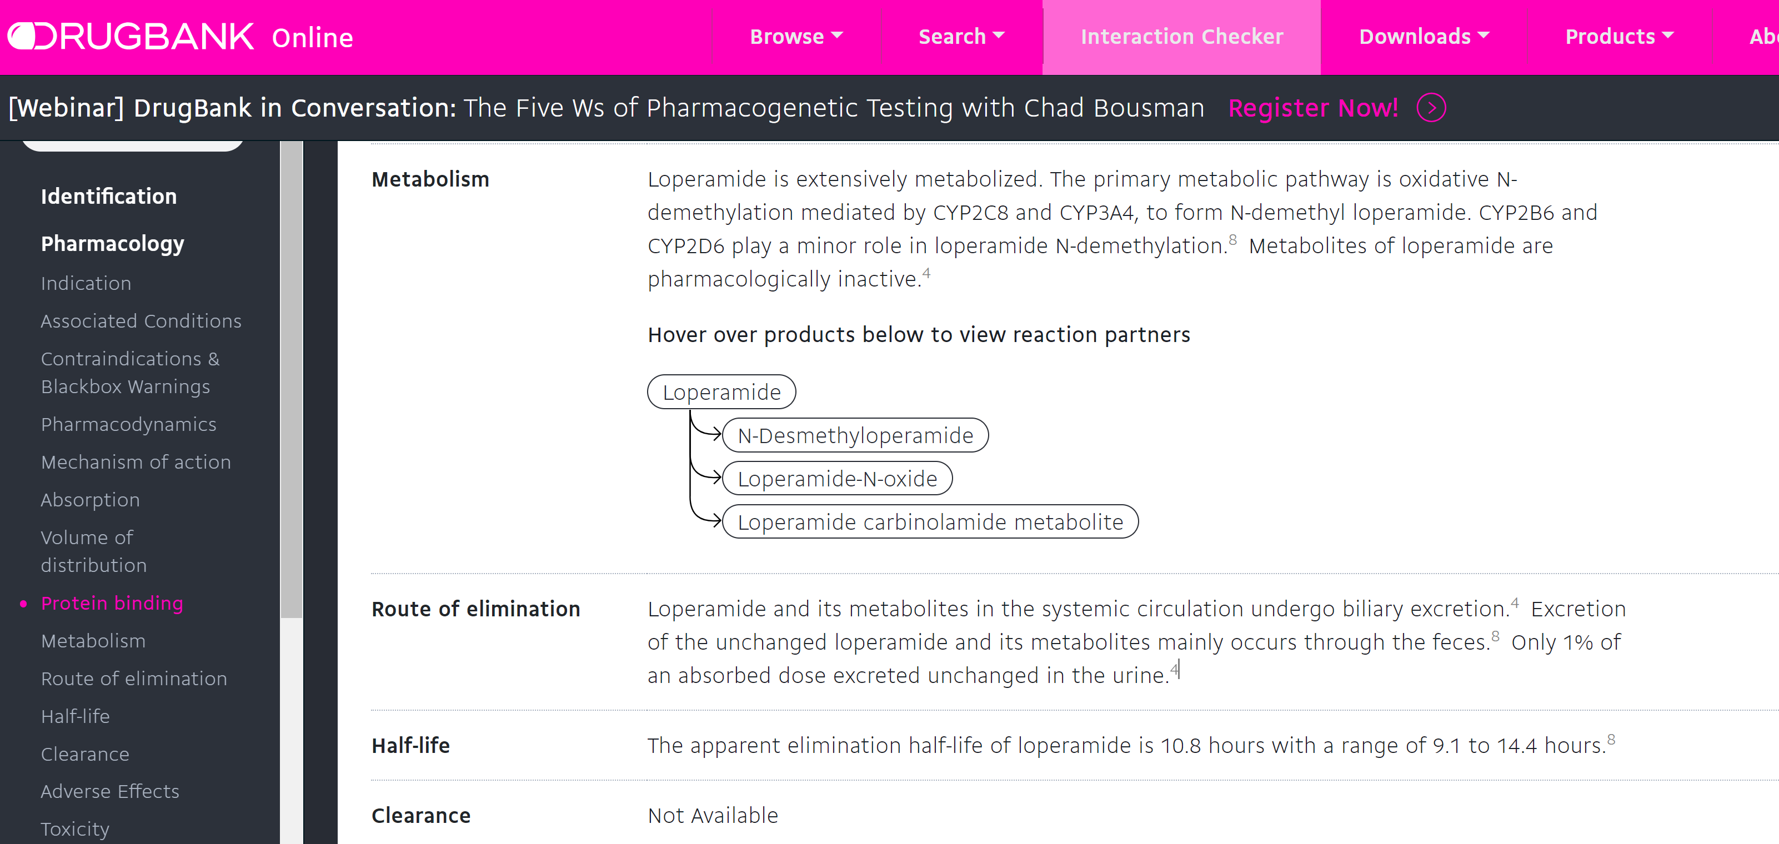

Slide 91
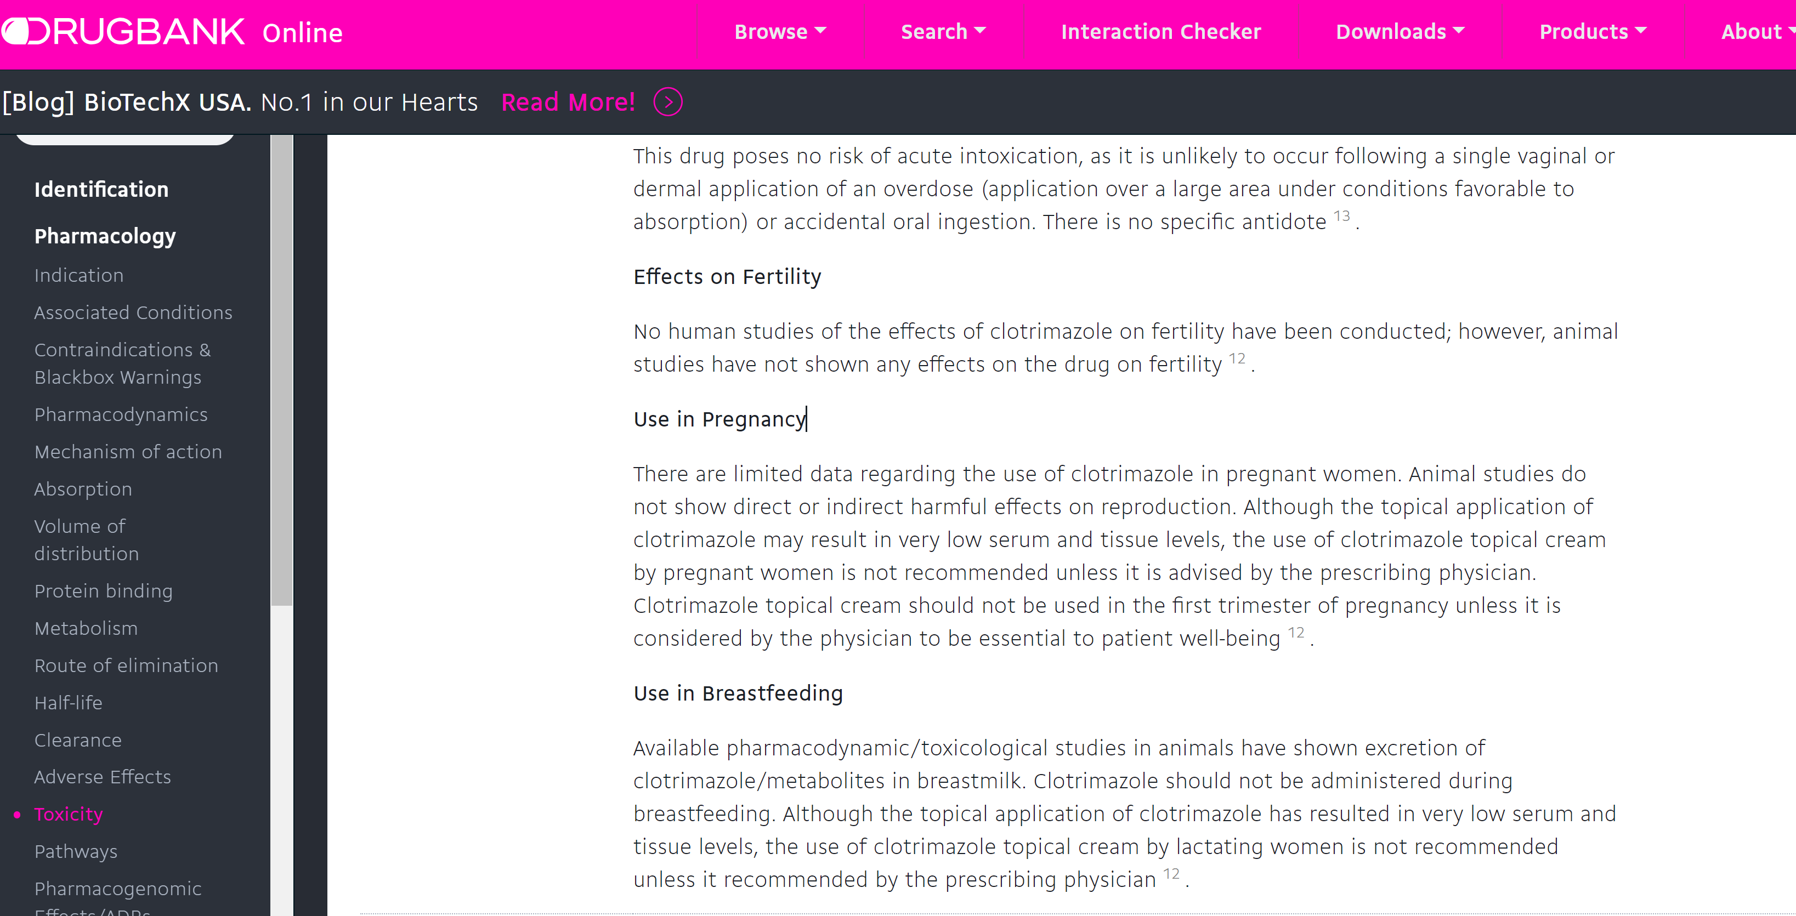

Slide 92
Thanks for attending!
Remember, our goals in the clinical cases is to develop the skill of investigating complex medical questions about medications and accurately convey that information to clients and colleagues.
Accuracy and safety is of utmost importance.
Notes:
https://pubmed.ncbi.nlm.nih.gov/

Slide 93
References
All clips of websites in this tutorial are referenced within the tutorial.
Please remember that it is a breach of academic integrity to copy other’s work and use that work as your own.
Please refer to the SCU Academic Integrity Policy for further information.

